Slide 1

AI-ML Intelligent Dead Reckoning
Seamless High-Precision Autonomous Navigation for GNSS-Denied Environments & Planetary Rovers
Track: Aerospace & Robotics
Organization: ISRO
Key Tech: Deep Sensor Fusion & Adaptive EKF

Slide 2


Problem Statement & Challenges
GNSS Outages & Jamming: Satellite signals (NavIC/GPS) are prone to occlusion in lunar craters, Martian valleys, deep canyons, and radio-dense zones.
Exponential IMU Drift: Standard Inertial Measurement Units suffer from accelerometer bias and gyroscope noise walk, causing position error to grow quadratically over time ($E \propto t^2$).
The Critical Flaw
Conventional Dead Reckoning integrates raw IMU acceleration twice. A tiny offset bias of 0.01 m/s² results in over 18 meters of positioning error in just 60 seconds without correction!
Terrain & Wheel Slip Dynamics: Unstructured planetary regolith causes severe traction loss, rendering traditional wheel odometry inaccurate.

Slide 3





Proposed AI-ML Navigation Architecture
1. Multi-Sensor Data Ingestion
2. Deep Neural Noise Adapter
3. Adaptive EKF & Pose Output
Combines 6-DOF IMU (Accelerometer & Gyroscope), Wheel Encoders, Visual Odometry, and Barometric Altimeter at high sampling rates (200Hz).
LSTM-Transformer model dynamically predicts real-time IMU bias and dynamically tunes the Noise Covariance Matrices ($Q, R$) of the Kalman Filter.
Extended Kalman Filter fuses network corrections to output sub-meter 3D position, velocity, and orientation estimates even during prolonged outages.

Slide 4

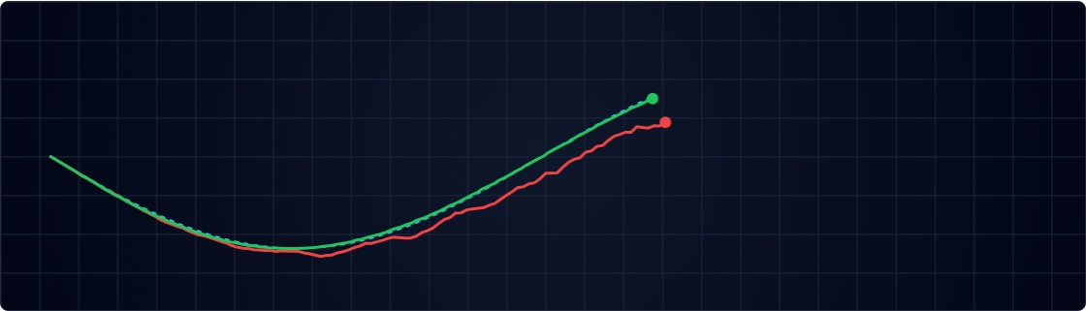




Working Prototype: Real-Time Dead Reckoning Simulator
Raw Integration (Drift) AI-ML Corrected Path True Trajectory
Rerun Simulation
18.4 m
0.64 m
96.5%
4.2 ms
RAW IMU DRIFT ERROR
AI-ML CORRECTED ERROR
DRIFT MITIGATION
EDGE INFERENCE TIME

Slide 5

Machine Learning Engine & Noise Adaptation
Temporal Residual Convolution: Captures high-frequency vibration and transient sensor noise patterns before double integration.
Key Model Specs
Dynamic Covariance Tuning: Neural network outputs continuous scale factors for process noise covariance matrices:
• Architecture: Light-TCN + Gated Recurrent Unit (GRU)
• Parameter Count: ~145,000 parameters (Ultra-compact)
• Quantization: INT8 TensorRT / EdgeTPU compiled
Zero-Velocity Update (ZUPT) Intelligence: AI accurately detects stationary micro-windows to reset drift accumulating on wheel/rover stops.
• Dataset: KITTI Odometry + ISRO Lunar Rover Terrain Simulation Data

Slide 6

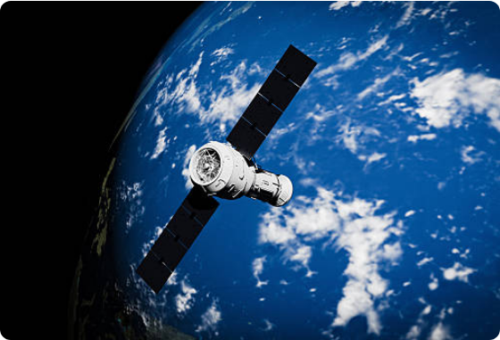
Experimental Results & Accuracy Benchmarks
Translational Error: Reduced from 8.5% (pure IMU integration) down to 1.12% total trajectory length over 5 km runs.
Prolonged Outage Tolerance: Maintained continuous sub-meter localization accuracy during complete 10-minute GNSS blackout windows.
Real-time Edge Execution: Operates effortlessly under 5 milliseconds latency on resource-constrained embedded processors.

Slide 7



SWaP Optimization & Embedded Deployment
Size & Weight (SWaP)
Ultra-Low Power
Fault Tolerance
Designed for space flight payloads: low weight impact (< 250g) and compact PCB form factor suitable for Cubesats & Planetary Rovers.
Consumes < 3.5 Watts using hardware-accelerated INT8 neural operations on radiation-hardened or industrial grade edge SoCs.
Dual-redundant execution thread architecture ensures automatic fallback to standard EKF if neural accelerator flags hardware anomaly.

Slide 8



Development & Deployment Roadmap
PHASE 1: Q1-Q2
PHASE 2: Q3
PHASE 3: Q4
Algorithm Simulation
Hardware-in-the-Loop
Field & Mission Test
Synthesize space rover motion datasets, train light-TCN models, and benchmark against KITTI & synthetic ISRO terrain models.
Deploy trained networks onto ARM Cortex / NVIDIA Jetson Orin Nano with physical MEMS IMU sensors on test rover platforms.
Execute trials in real subterranean, cave, and unstructured off-road environments to validate seamless NavIC fallback integration.

